Slide 1
تحلیل داده های مکانی در نرم افزار R

Slide 2
R Fundamentals
Tidy Data
Visualization
Spatial Data
Machine Learning
geostatistics
Spatial Sampling

Slide 3

An Overview of Programming with R

Slide 4
Content
Basics
R and RStudio
Setting up an R session
Data types
Data structures
Selecting subsets
Functions
Import/export of data

Slide 5

Programming is NOT Easy!

Slide 6

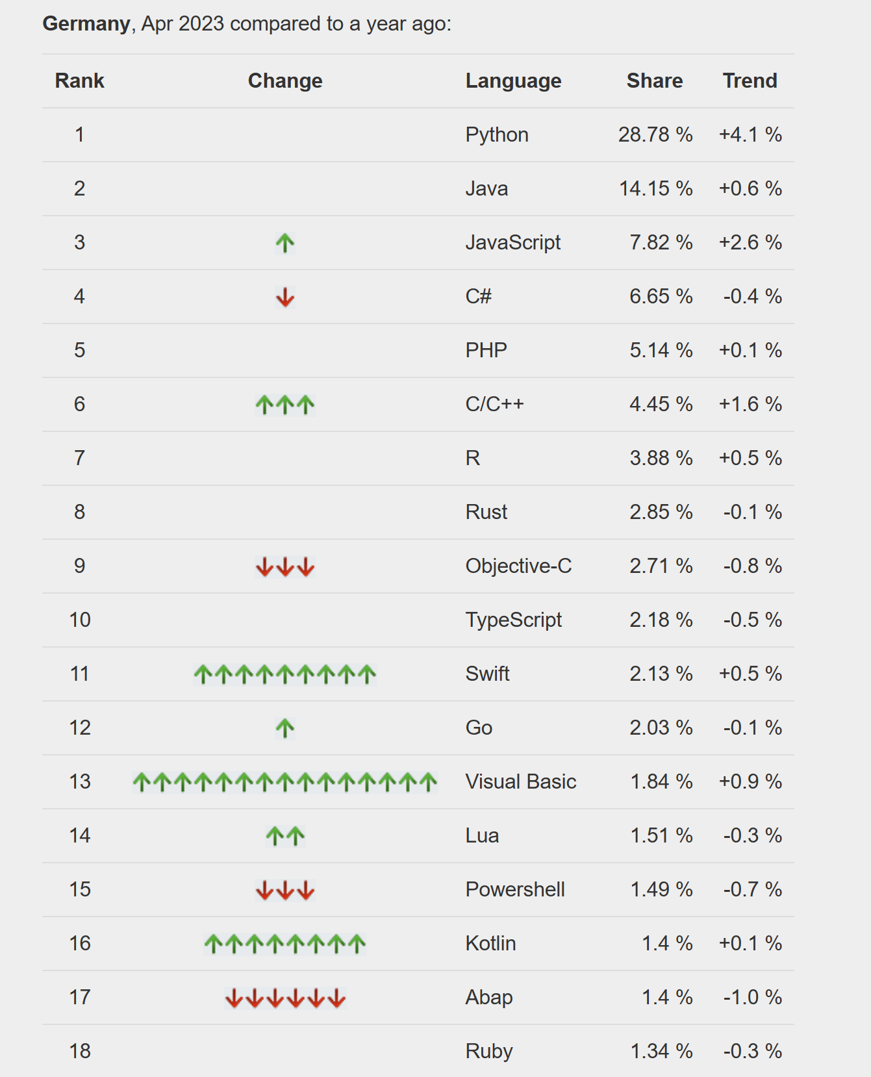
Most Popular Programming Languages for 2023
https://www.netsolutions.com/insights/most-popular-programming-languages/

Slide 7

Why R?
It is free
Available for the most popular operating systems
Low system requirements
Continuous further development
Active user community with its own conference (useR!)
Application in many applied sciences
Integrate with other languages
Easy to learn

Slide 8

Starting out in R
Download software:
Install R: https://cran.r-project.org/
Install RStudio: https://posit.co/download/rstudio-desktop/

Slide 9
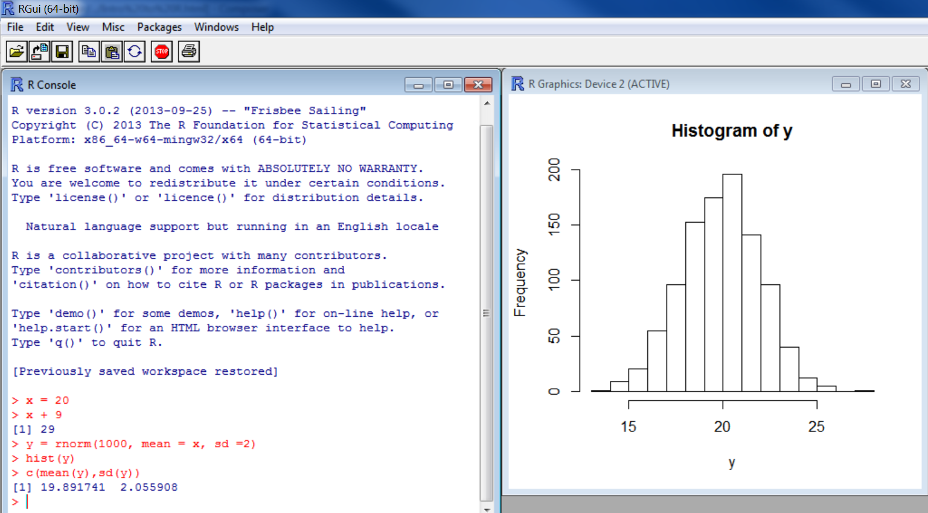
A snapshot of RGui

Slide 10
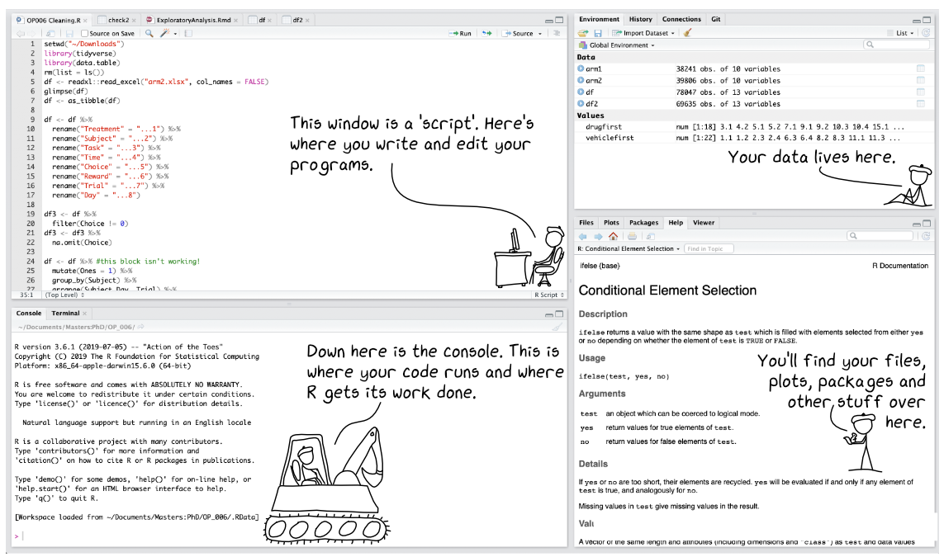
A snapshot of RStudio
Environments
Source
Console
Output
https://r-unimelb.gitbook.io/rbook/introduction-to-r-and-rstudio/introduction-to-rstudio

Slide 11
File:
Opens new file
Creates new project
Open existing files/projects
Source Window
Green plus:
Open new files (e.g. script)
Floppy disk:
save
Run:
Runs (executes)
code in your script
Name of script / file

Slide 12
Console Window
> Command prompt
Where you type code or ‘run’ code from your script

Slide 13
Console Window
Error message: check and fix
Warning message: check and understand, perhaps fix
+ sign: R is expecting more from you

Slide 14
Output Window
type here to get help

Slide 15
Output Window
What does the function return
What the function does in general terms
How to use the function
What does the function need
Discover other related functions
Sample code showing how it works

Slide 16
Essentials of R
Basic arithmetic functions:
Addition 7 + 4 => 11
Subtraction 7 - 4 => 3
Multiplication 7 * 2 => 14
Division 7 / 2 => 3.5
Exponentiation 7 ^ 2 => 49

Slide 17
Essentials of R
Basic arithmetic functions:
Logarithms and exponentials log2 (4) => 2
Trigonometric functions cos (4) => 0.65
Other mathematical functions sqrt (4) => 2
Use parentheses to group operations in order to force the order of evaluation.
7 + 4 * 3 => 19
(7 + 4) * 3 => 33

Slide 18
Essentials of R
Assigning values to variables:
V1 <- 5
V2 <- 10
V3 <- 15
V1 + V2 + V3 => 30
V4 <- c(1,2,3)
V5 <- c(4,5,6)
V4 + V5 => c(5,7,9)

Slide 19
Essentials of R
Data Types:
Logicals
Integers
Doubles
Complex Numbers
Strings
=> TRUE or FALSE
=> 1L, 2L
=> 3.4, 1
=> 0 + 1i
=> ”Hello”, ”10”
To check the data types: typeof()
To change data types: as.logical();as.numeric();as.character ……

Slide 20
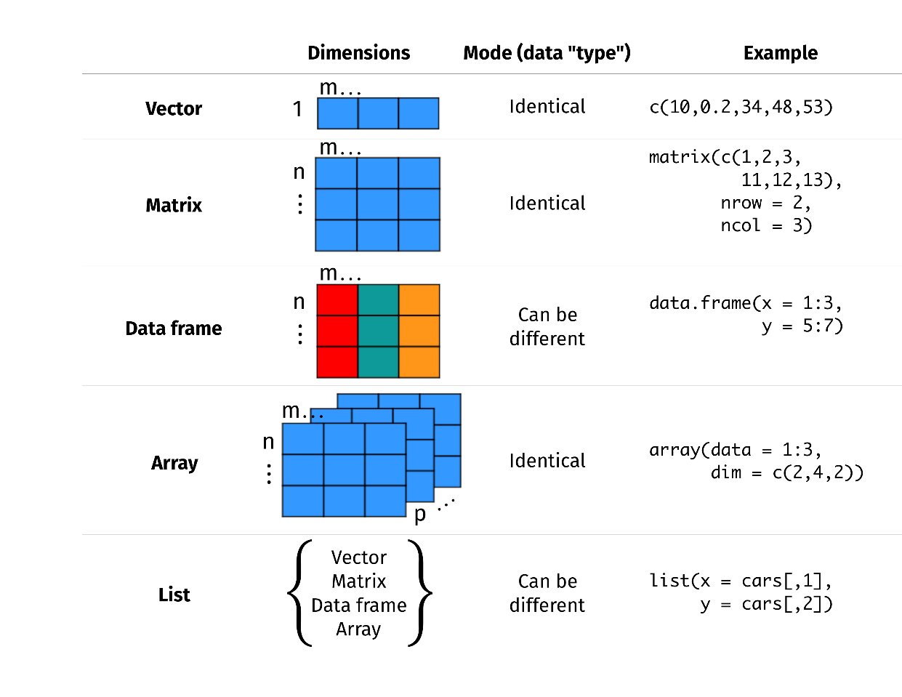
Essentials of R
Data structure:
To check data structure: str()
https://r.qcbs.ca/workshop01/workshop01-en/workshop01-en.html#98

Slide 21
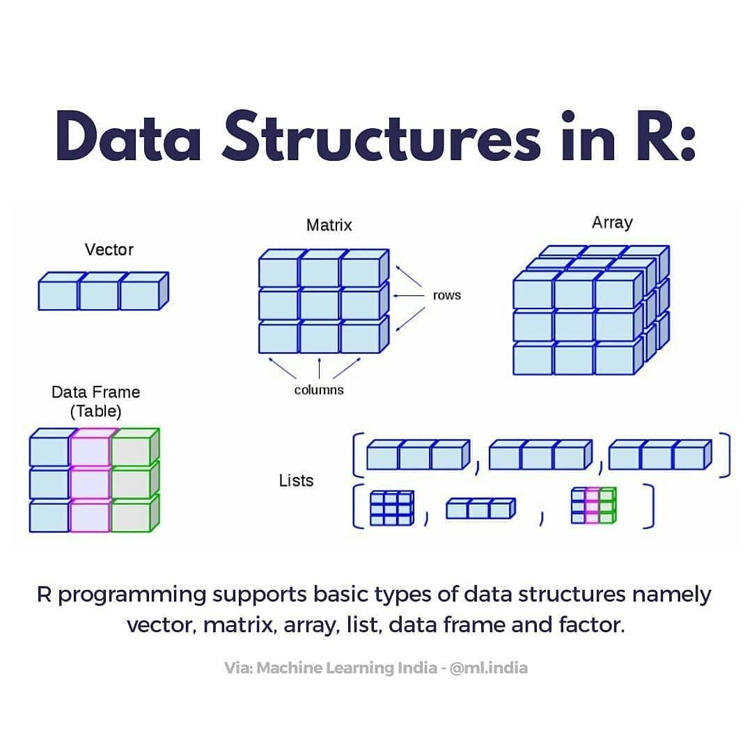
Essentials of R
V4 <- c("a", "f", "c", "d", "e")
Vector:
# a logical vector
V1 <- c(TRUE, TRUE, FALSE)
# an integer vector
V2 <- c(1:10)
# a numeric vector
V3 <- V2 + 0.1
# a character vector
V4 <- c("a", "f", "c", "d", "e")
V4[2] => “f"
V4[-2] => "a" "c" "d" "e"
V4[2:3] => “f" “c"
V4[2] <- “b“ => "a", “b", "c", "d", "e"

Slide 22
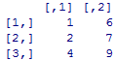
Essentials of R
Matrix:
V1 <- matrix (c(1,2,4,6,7,9) , byrow=FALSE, nrow=3)
V1[3,1] => 4
V1[3,2] => 9

Slide 23
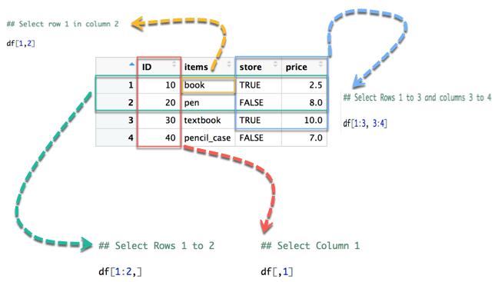
Essentials of R
Data frame:
https://www.guru99.com/r-data-frames.html

Slide 24
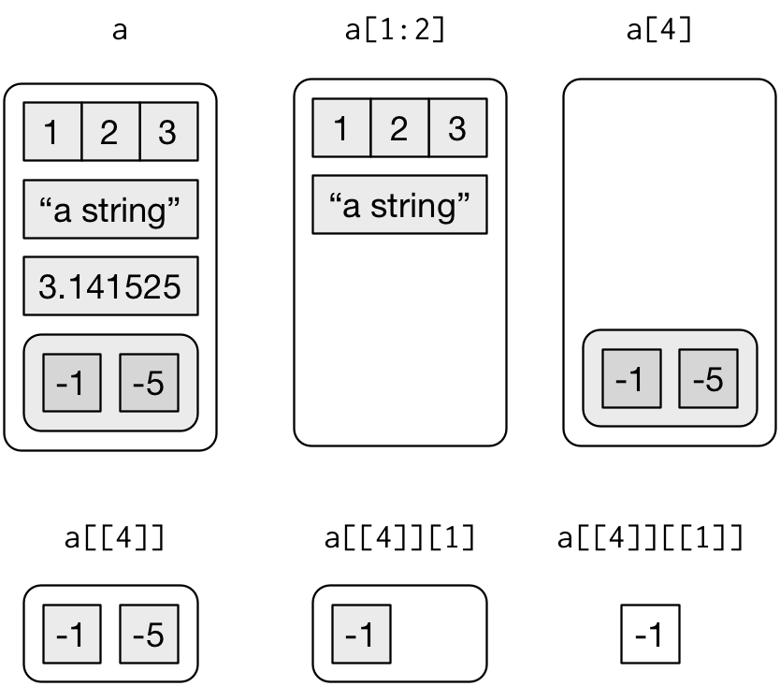
Essentials of R
List:
https://www.guru99.com/r-data-frames.html

Slide 25
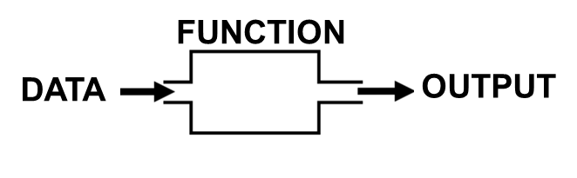
Essentials of R
Functions:
Data analyses and modelling is done through functions.
V1 <- c(1,2,3)
mean(V1) = 2

Slide 26
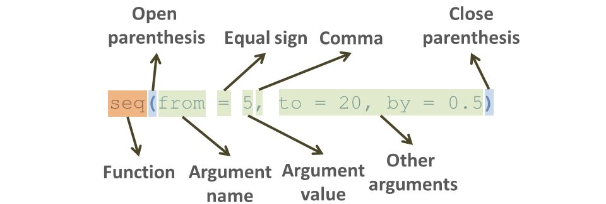
Essentials of R
Functions:

Slide 27


Essentials of R
Packages:
# install packages
install.packages("package name")
# load packages
library("package name")
https://roelverbelen.netlify.app/resources/r/packages/

Slide 28
Essentials of R
Packages:
Soil Science
Data analysis
Archaeology
Plotting
GIS and Mapping
Machine Learning

Slide 29

Summary
Install software and
Write codes ………….

